Slide 1
TRANSFORMING Image Recognition and Classification
(Using CIFAR 100 & Google Landmarks Dataset v2)
Spring 2023 Term: W281 Computer Vision Final Project
Waqas Ali | Pedro Melendez | Prakash Krishnan
Notes:
Waqas

Slide 2
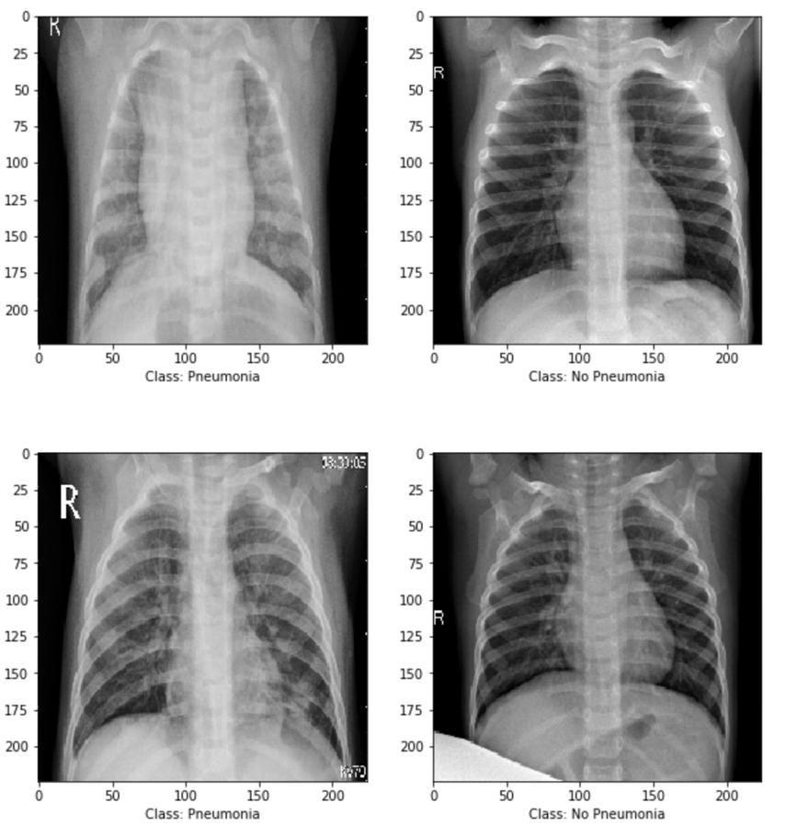
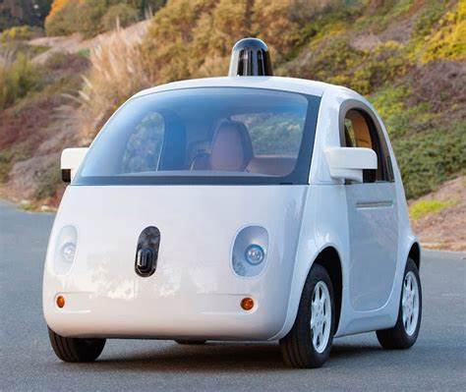

Image Classification
Essential Task in Computer Vision
Considerable Research on Handcrafted Techniques with Traditional Classifiers (SVM, RF, Gradient Boost) and deep learning models (CNN and ViT)
Use Cases – Medical Imaging, Satellite Imaging, Self Driving Cars
Emergence of Vision-Language Models
Notes:
Waqas

Slide 3
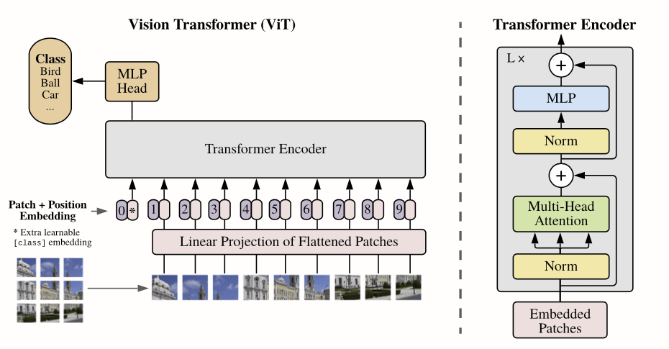
Our Inspiration
An Image is Worth 16x16 Words - Transformers for Image Recognition at Scale (Dosovitskiy et al., Google Research, 2021)
Self-Attention based transformer architecture (Source: Attention Is All You Need, Ashish Vaswani et al., 2017) adapted for images
Vision Transformer Steps
- Break image into patches (fixed sizes)
- Integrate positional embeddings
- Feed the sequence to the transformer encoder
- Pre-train the ViT model with image labels
- Fine-tune the downstream dataset for image classification
Source: An Image is Worth 16x16 Words: Transformers for Image Recognition at Scale
Notes:
Waqas

Slide 4
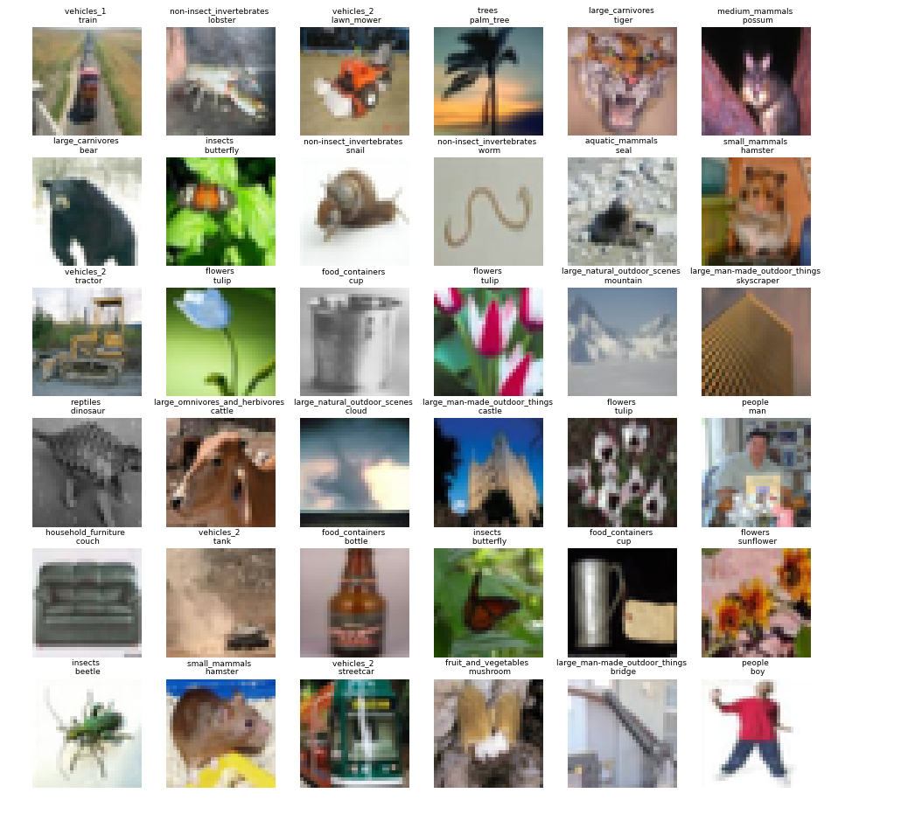
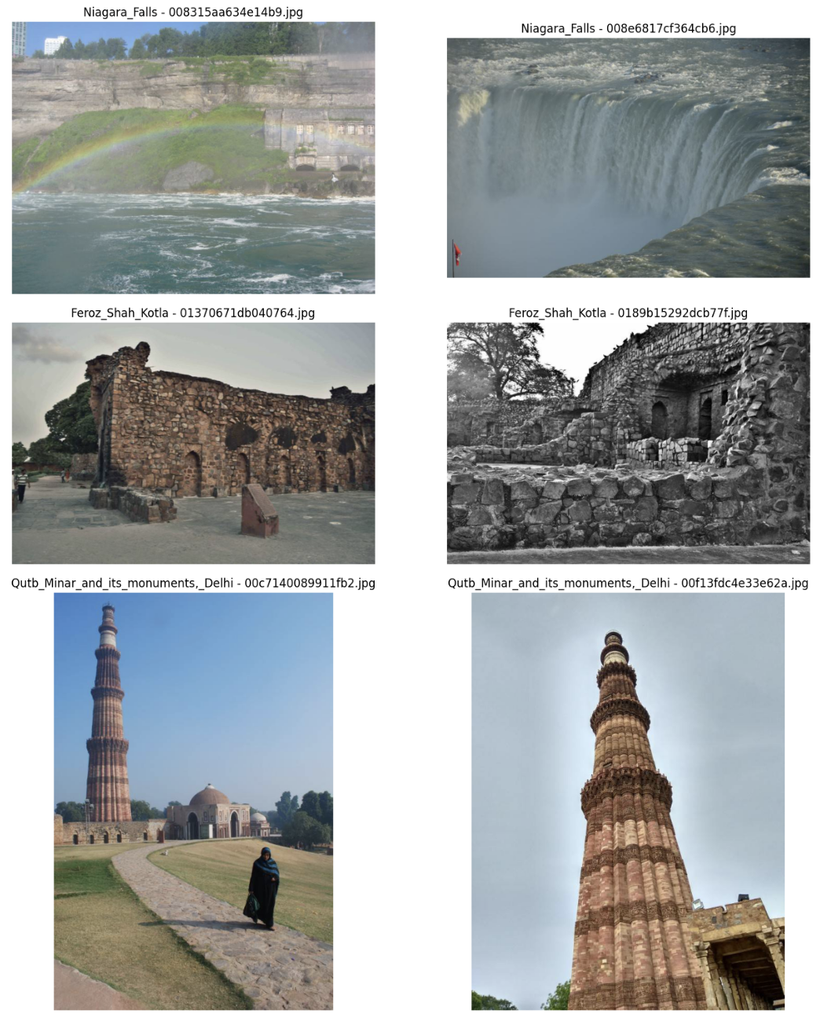
Research Questions
How well does a Pre-Trained Vision Transformer Model (ViT) that is Fine Tuned compare to CNN models (ResNet 9 & ResNet 50) and models built on manual feature extraction techniques (HOG+SVM, SIFT+SVM, GLCM+SVM) ?
How does the state-of-the-art ViT model generalize and scale ?
What is the future of ViTs ?
CIFAR-100, 50k Train, 10k Test, 20 Coarse Class and 100 Fine Class
Subset of GLDv2 dataset with only 20 classes and 16,633 images in total
Notes:
Waqas
The business problem we were asked to solve is that Acme Gourmet Meals is looking to expand their business by exploring new delivery and pickup options. We are planning on looking into a wide variety of possibilities, such as in store and vending machine pickup, and delivery options like public transportation, drones, and robots.

Slide 5
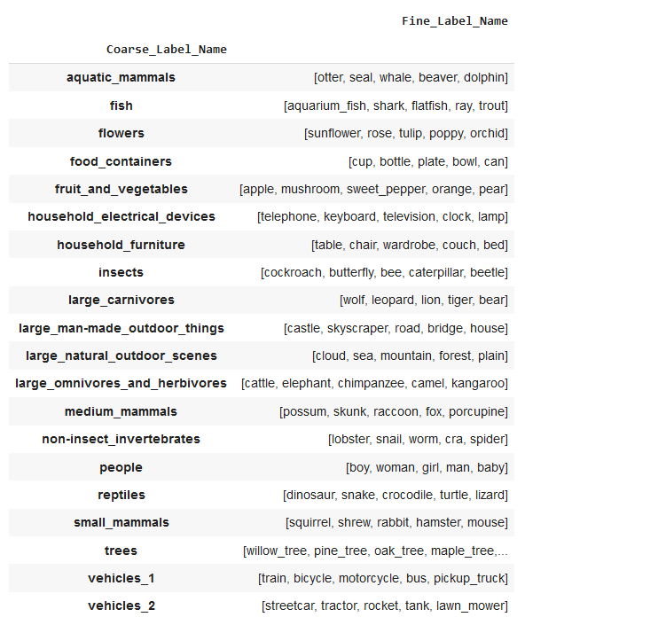
CIFAR-100 Dataset EDA
Dataset has 100 classes (fine labels) containing 600 images each.
There are 500 training images and 100 testing images per class.
The 100 classes in the CIFAR-100 are grouped into 20 superclasses (course labels).
Each image (32x32) comes with a "fine" label (the class to which it belongs) and a "coarse" label (the superclass to which it belongs).
Notes:
Prakash

Slide 6
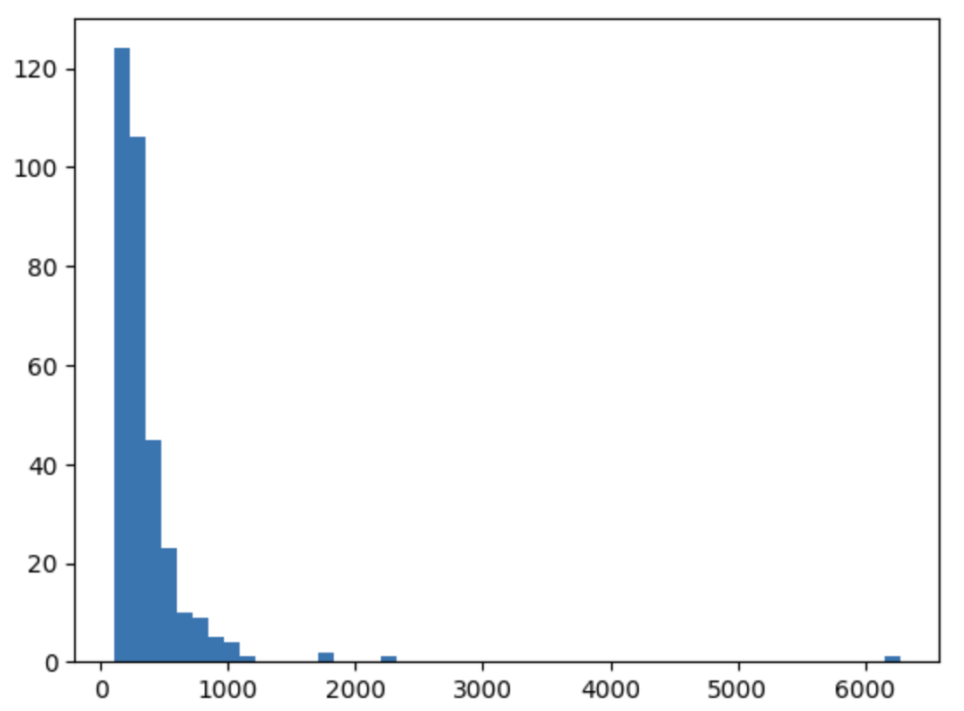
GLDv2 Dataset EDA
Main dataset contains over 4 million images of landmarks across the word, we used Kaggle subset with:
1,580,470 images and 81,313 Classes (105.52 GB)
Only 48 Classes had more than 500 images
We used the top 20 classes with less than 1,000 images to avoid outliers and unbalanced classes
Most images had 800x800 resolution so we blurred and downsized to 200x200
Our dataset included 16,633 images (1.8GB)
Histogram of images per class
Notes:
prakash

Slide 7
Methodology
Image Acquisition
CIFAR-100 / GLDv2
Image Pre-Processing
Resize, Gray Scale, Floating Point
Handcrafted Feature Extraction Techniques
Evaluation Metrics on Test Data
Accuracy
Precision
Recall
F1-Score
Confusion Matrix
Visual Inspection of Predicted Labels
HOG
SIFT
GLCM
CNN
ViT
Feature Vector
Feature Vector
Feature Vector
Feature Extraction and Train
Feature Extraction
Train the Model
Train the Model
Train the Model
Predict the Model
Predict the Model
Predict the Model
Predict the Model
Predict the Model
Deep Learning Models
Notes:
Prakash

Slide 8
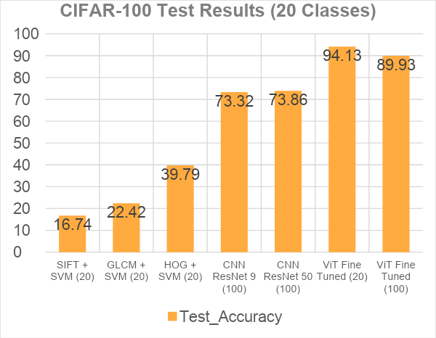
Experimental Results on CIFAR-100
Key Takeaways
Vision Transformer outperforms CNN and Handcrafted Models on Test Accuracy
Vision Transformer scales well even when number of classes go from 20-100
Best CNN performance on ResNet 50 but still inferior to Vision Transformer Model
Best performance from handcrafted models is HOG + SVM. But performance is inferior to deep learning models
Handcrafted feature extraction techniques do not scale well when dealing with multiple features like edges, blobs, regions, textures, shapes.
Neural Networks
Notes:
prakash

Slide 9
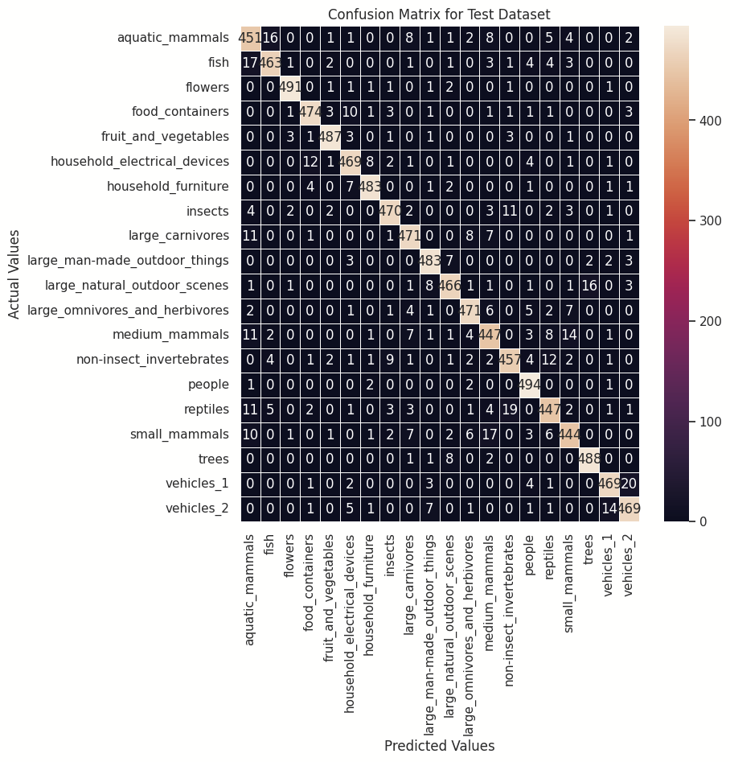
Experimental Results on CIFAR-100 - Continued
Coarse Class | Accuracy | Coarse Class | Accuracy | Coarse Class | Accuracy
aquatic_mammals | 89.6% | insects | 93.2% | people | 98.2%
fish | 93.8% | large_carnivores | 92.0% | reptiles | 89.6%
flowers | 98.4% | large_man-made_outdoor_things | 94.8% | small_mammals | 91.2%
food_containers | 94.0% | large_natural_outdoor_scenes | 95.4% | trees | 97.0%
fruit_and_vegetables | 97.2% | large_omnivores_and_herbivores | 94.0% | vehicles_1 | 93.2%
household_electrical_devices | 93.6% | medium_mammal s | 93.0% | vehicles_2 | 94.8%
household_furniture | 96.0% | non-insect_invertebrates | 93.6%
Key Takeaways
Classes that are distinct and have good features have higher accuracy rates.
As an example flowers, people, trees, fruits and vegetables have the highest accuracy rates.
Aquatic mammals and reptiles have the lowest accuracy rates.
These classes are not distinctive and have other classes such as small mammals and medium mammals that are close.
Notes:
Prakash

Slide 10
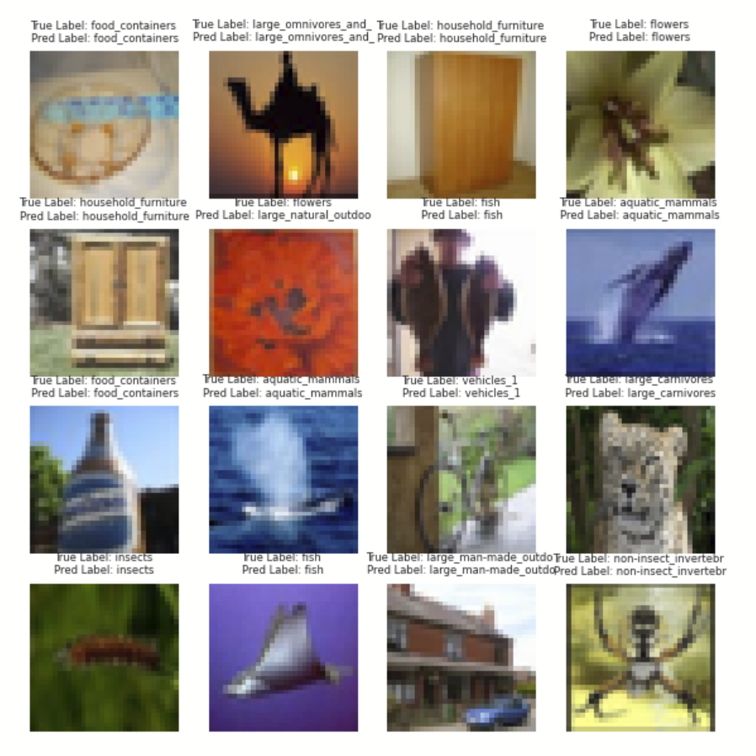
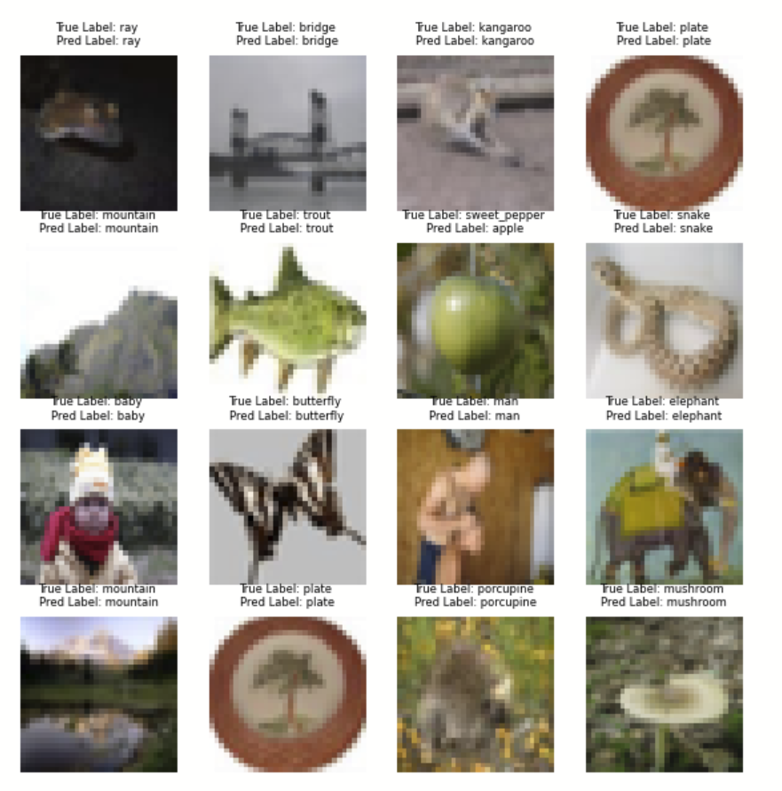
Sample Test Images and Predictions from CIFAR- 100
Coarse Label Prediction
Fine Label Prediction
Notes:
prakash

Slide 11
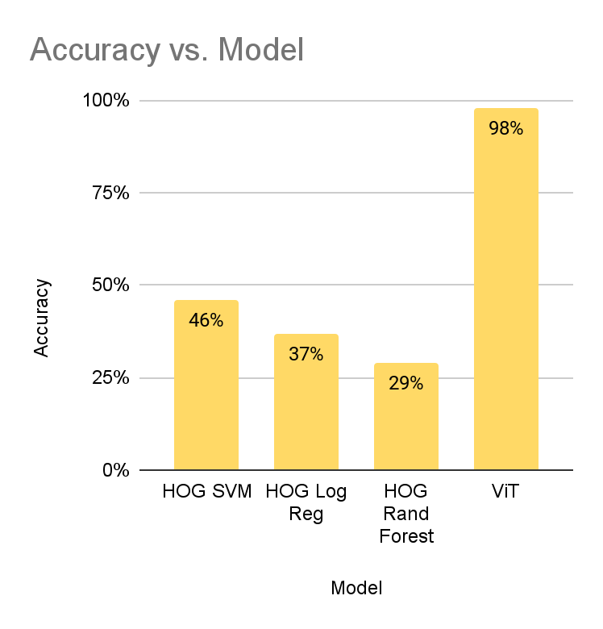
Experimental Results on GLDv2
Key Takeaways
Extremely high accuracy (98%) with Vision Transformer
Vision Transformer accuracy 2x of Handcrafted Models
Vision Transformer had better accuracy with GLDV2 compared to CIFAR due to better resolution on images
HOG+SVM had higher accuracy compared to HOG+LR and HOG+RF
Notes:
Pedro

Slide 12
Generalizability CIFAR-100
 | Test Evaluation
Models | Accuracy | Precision | Recall | F1-Score
ViT - CIFAR-100 (20 Classes) | 94.13 | 94.15 | 94.13 | 94.13
ViT - CIFAR-100 (100 Classes) | 89.93 | 90.11 | 89.30 | 89.95
CNN-ResNet 9 (100 Classes) | 73.32 | 73.56 | 73.32 | 73.32
CNN-ResNet 50 (100 Classes) | 73.86 | 74.1 | 73.86 | 73.85
Key Takeaways
ViT on CIFAR-100 does remarkably well on Test Accuracy with 94.13% for 20 course labels and 89.93% on 100 fine labels.
CNN-ResNet 9 and 50 perform well but inferior to ViT (CNN is not pre-trained)
Notes:
Pedro

Slide 13
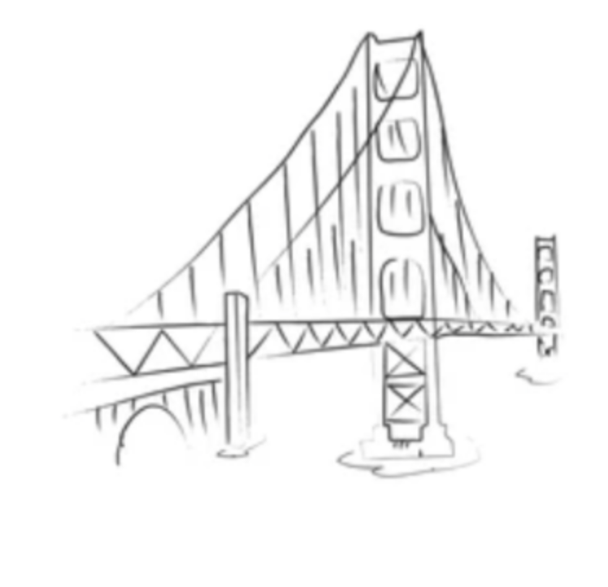
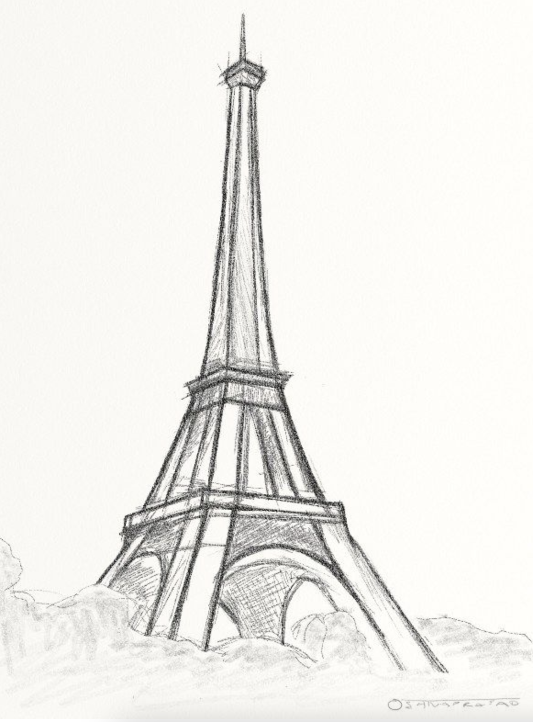

Generalizability GLDv2
ViT model classified correctly even draw images of some of the landmarks
Tested with low detailed sketches and with full colored drawings and still got the correct label
Notes:
Pedro

Slide 14

Conclusion
Vision Transformers achieve outstanding classification accuracy across large, complex datasets (including GLDv2) even when the numbers of classes are large (100).
Traditional techniques work well on datasets that have homogeneous features but underperform when images have non-homogeneous features.
Future studies can include experiments to determine under what conditions a ViT may underperform CNN.
Combining features extracted by a ViT with handcrafted techniques can address some of the intra-class variations and inter-class similarities especially with medical-imaging applications.
Using multi-modal transformer models with NLP and CV can lead to interesting use cases.
Notes:
Waqas

